Slide 1

機器學習－第三次報告
4_7108053117_陳慧如
指導教授：彭冠舉
日期：2020/01/08

Slide 2
Deng, Y., Bao, F., Kong, Y., Ren, Z., & Dai, Q. (2017). Deep Direct Reinforcement Learning for Financial Signal Representation and Trading. IEEE Transactions on Neural Networks and Learning Systems
1
FDRNN
Notes:
決策吃前一期的決策
前一期的決策又會吃到前前一期的決策
就好像看著K線圖再預測股價一樣
##<多少賣 >多少買 設variable?
C遞減 兩個時間點兩個時間點慢慢降回去

Slide 3
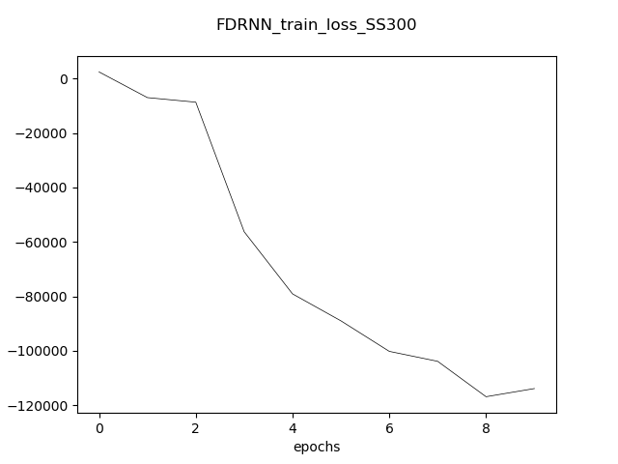
Deng, Y., Bao, F., Kong, Y., Ren, Z., & Dai, Q. (2017). Deep Direct Reinforcement Learning for Financial Signal Representation and Trading. IEEE Transactions on Neural Networks and Learning Systems
1
SHSZ300(滬深300)
Accumulated profit(%)
2005-04-08
today
60%

Slide 4
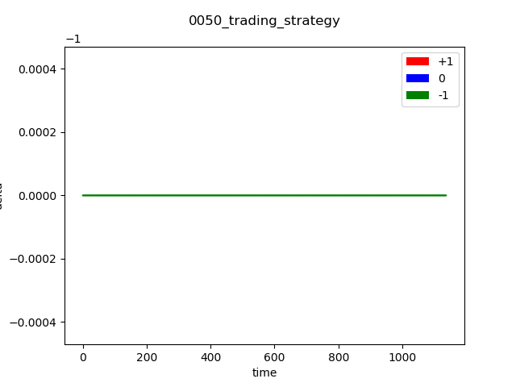
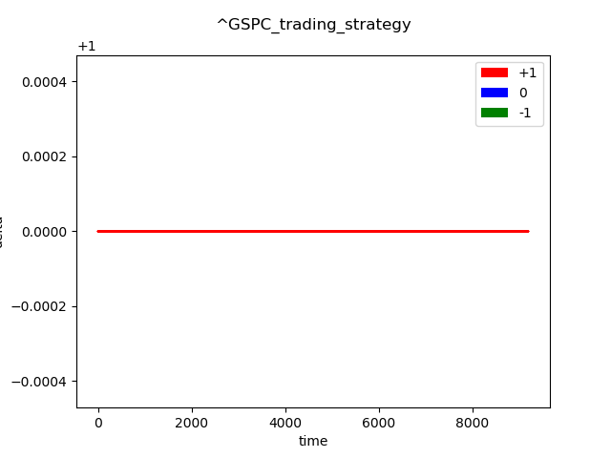
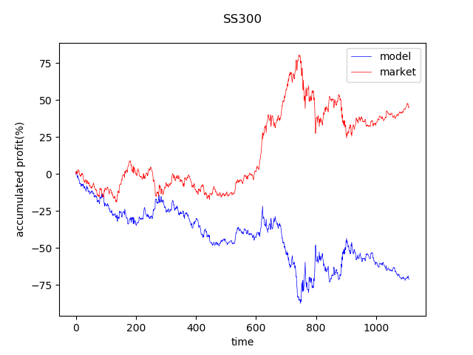
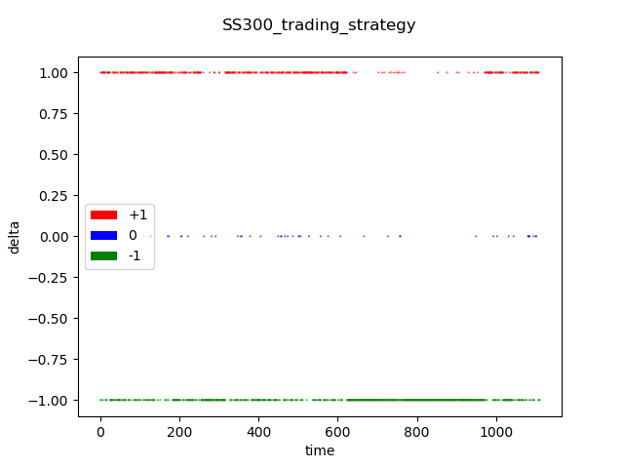
Deng, Y., Bao, F., Kong, Y., Ren, Z., & Dai, Q. (2017). Deep Direct Reinforcement Learning for Financial Signal Representation and Trading. IEEE Transactions on Neural Networks and Learning Systems
1
0050
S&P500

Slide 5
Jeong, G., & Kim, H. Y. (2019). Improving financial trading decisions using deep Q-learning: Predicting the number of shares, action strategies, and transfer learning. Expert Systems with Applications
2
DQN +num
Notes:
決策吃前一期的決策
前一期的決策又會吃到前前一期的決策
就好像看著K線圖再預測股價一樣
##<多少賣 >多少買 設variable?
C遞減 兩個時間點兩個時間點慢慢降回去

Slide 6
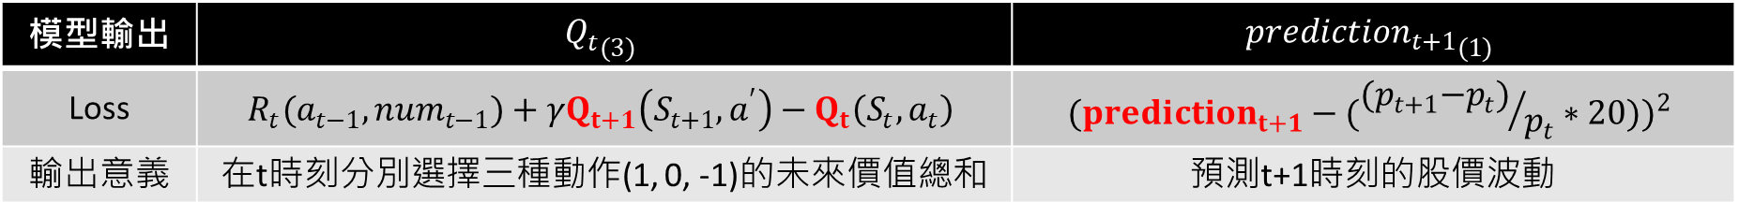

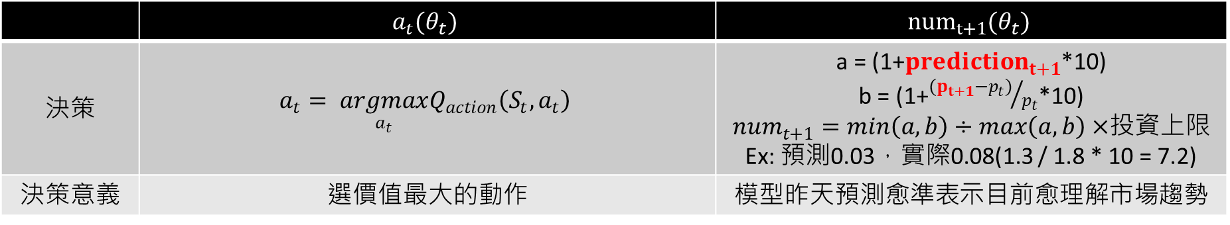
Jeong, G., & Kim, H. Y. (2019). Improving financial trading decisions using deep Q-learning: Predicting the number of shares, action strategies, and transfer learning. Expert Systems with Applications
Model_3
Rup今天$以前 {{{(p}_{t}−p_{t−1})}/{p_{t−1}}}_{(200)}→$ ${fc1}_{(100)}$ $→{fc2}_{( 50 )}→{fc3}_{(20)}→{Q_{t}}_{(3)}$
$P_{(200)}→$ $→ {fc2}_{( 50 )}→{fc3}_{(20)}$ $→{{prediction}_{t+1}}_{(1)}$
act branch
num branch
模型輸出 | $${Q_{t}}_{(3)}$$ | $${{prediction}_{t+1}}_{(1)}$$
Loss | $$R_{t}(a_{t−1},{num}_{t−1})+γQ_{t+1}\left(S_{t+1}, a^{′}\right)−Q_{t}\left(S_{t}, a_{t}\right)$$ | $${({prediction}_{t+1}−({{(p}_{t+1}−p_{t})}/{p_{t}}∗20))}^{2}$$
輸出意義 | 在t時刻分別選擇三種動作(1, 0, -1)的未來價值總和 | 預測t+1時刻的股價波動
 | $$a_{t}(θ_{t})$$ | $${num}_{t+1}(θ_{t})$$
決策 | $$a_{t}= \underset{a_{t}}{argmax}Q_{action}\left(S_{t}, a_{t}\right)$$ | a = (1+${prediction}_{t+1}$*10) b = (1+${{(p}_{t+1}−p_{t})}/{p_{t}}$*10) ${num}_{t+1}=min\left(a,b\right)÷max\left(a, b\right)×$投資上限 Ex: 預測0.03，實際0.08(1.3 / 1.8 * 10 = 7.2)
決策意義 | 選價值最大的動作 | 模型昨天預測愈準表示目前愈理解市場趨勢

Slide 7
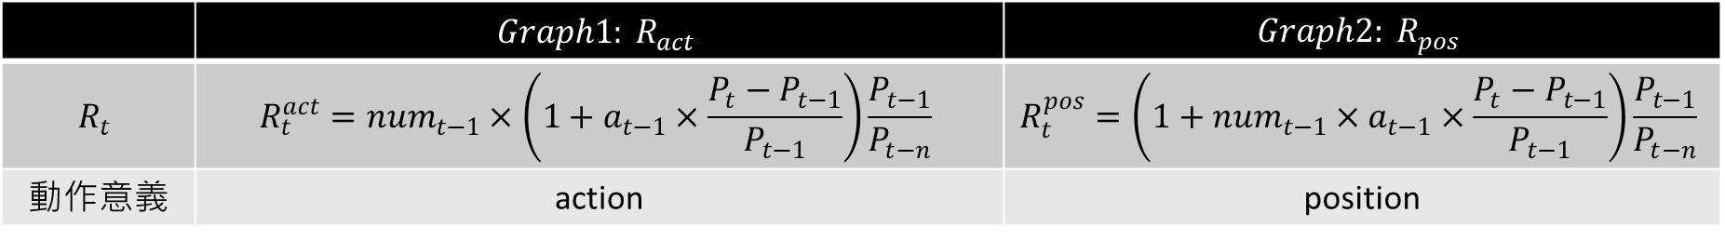
Jeong, G., & Kim, H. Y. (2019). Improving financial trading decisions using deep Q-learning: Predicting the number of shares, action strategies, and transfer learning. Expert Systems with Applications
Model_3
Rup今天$以前 {{{(p}_{t}−p_{t−1})}/{p_{t−1}}}_{(200)}→$ ${fc1}_{(100)}$ $→{fc2}_{( 50 )}→{fc3}_{(20)}→{Q_{t}}_{(3)}$
$P_{(200)}→$ $→ {fc2}_{( 50 )}→{fc3}_{(20)}$ $→{{prediction}_{t+1}}_{(1)}$
act branch
num branch
模型輸出 | $${Q_{t}}_{(3)}$$ | $${{prediction}_{t+1}}_{(1)}$$
Loss | $$R_{t}(a_{t−1},{num}_{t−1})+γQ_{t+1}\left(S_{t+1}, a^{′}\right)−Q_{t}\left(S_{t}, a_{t}\right)$$ | $${({prediction}_{t+1}−({{(p}_{t+1}−p_{t})}/{p_{t}}∗20))}^{2}$$
 | $$Graph1: R_{act}$$ | $$Graph2: R_{pos}$$
$$R_{t}$$ | $$R_{t}^{act}={num}_{t−1}×\left(1+a_{t−1}×\frac{P_{t}−P_{t−1}}{P_{t−1}}\right)\frac{P_{t−1}}{P_{t−n}}$$ | $$R_{t}^{pos}=\left(1+{num}_{t−1}×a_{t−1}×\frac{P_{t}−P_{t−1}}{P_{t−1}}\right)\frac{P_{t−1}}{P_{t−n}}$$
動作意義 | action | position

Slide 8
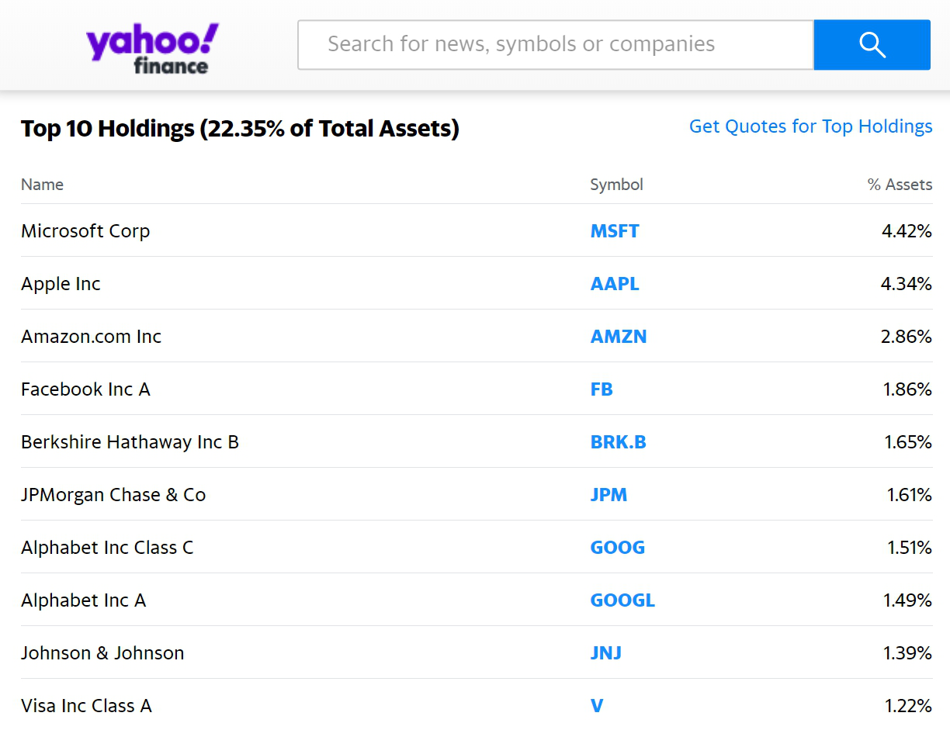
Jeong, G., & Kim, H. Y. (2019). Improving financial trading decisions using deep Q-learning: Predicting the number of shares, action strategies, and transfer learning. Expert Systems with Applications
Stock index: S&P500
Component stocks
pretrain

Slide 9

Jeong, G., & Kim, H. Y. (2019). Improving financial trading decisions using deep Q-learning: Predicting the number of shares, action strategies, and transfer learning. Expert Systems with Applications
Model_3
Rup今天$以前 {{{(p}_{t}−p_{t−1})}/{p_{t−1}}}_{(200)}→$ ${fc1}_{(100)}$ $→{fc2}_{( 50 )}→{fc3}_{(20)}→{Q_{t}}_{(3)}$
$P_{(200)}→$ $→ {fc2}_{( 50 )}→{fc3}_{(20)}$ $→{{prediction}_{t+1}}_{(1)}$
act branch
num branch
2012-05-18
today
Component stocks
60%
40%
S&P500
60%
40%
實驗步驟
(1) Pretrain num
(2) Pretrain act
(3) Pretrain num+act
(5) Test
(4) Pretrain index
epochs = 3
epochs = 3
epochs = 3
epochs = 3
epochs = 1

Slide 10
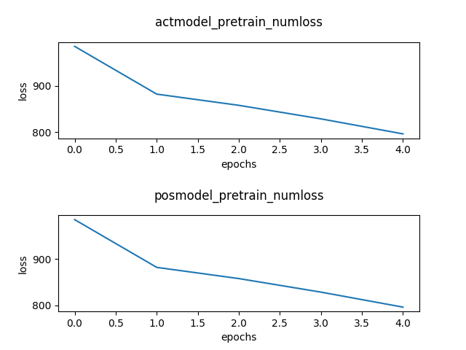


Model_3
Rup今天$以前 {{{(p}_{t}−p_{t−1})}/{p_{t−1}}}_{(200)}→$ ${fc1}_{(100)}$ $→{fc2}_{( 50 )}→{fc3}_{(20)}→{Q_{t}}_{(3)}$
$P_{(200)}→$ $→ {fc2}_{( 50 )}→{fc3}_{(20)}$ $→{{prediction}_{t+1}}_{(1)}$
act branch
num branch
pretrain num loss
實驗步驟
(1) Pretrain num
(2) Pretrain act
(3) Pretrain num+act
(5) Test
(4) Pretrain index
epochs = 3
epochs = 3
epochs = 3
epochs = 3
epochs = 1

Slide 11

Jeong, G., & Kim, H. Y. (2019). Improving financial trading decisions using deep Q-learning: Predicting the number of shares, action strategies, and transfer learning. Expert Systems with Applications
Model_3
Rup今天$以前 {{{(p}_{t}−p_{t−1})}/{p_{t−1}}}_{(200)}→$ ${fc1}_{(100)}$ $→{fc2}_{( 50 )}→{fc3}_{(20)}→{Q_{t}}_{(3)}$
$P_{(200)}→$ $→ {fc2}_{( 50 )}→{fc3}_{(20)}$ $→{{prediction}_{t+1}}_{(1)}$
act branch
num branch
2012-05-18
today
Component stocks
60%
40%
S&P500
60%
40%
實驗步驟
(1) Pretrain num
(2) Pretrain act
(3) Pretrain num+act
(5) Test
(4) Pretrain index
epochs = 3
epochs = 3
epochs = 3
epochs = 3
epochs = 1

Slide 12
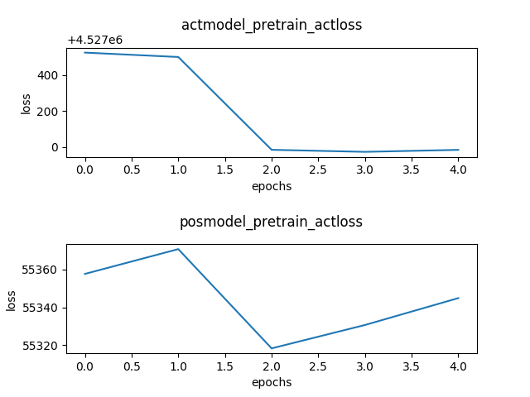

Model_3
Rup今天$以前 {{{(p}_{t}−p_{t−1})}/{p_{t−1}}}_{(200)}→$ ${fc1}_{(100)}$ $→{fc2}_{( 50 )}→{fc3}_{(20)}→{Q_{t}}_{(3)}$
$P_{(200)}→$ $→ {fc2}_{( 50 )}→{fc3}_{(20)}$ $→{{prediction}_{t+1}}_{(1)}$
act branch
pretrain act loss
num branch
pretrain act loss
實驗步驟
(1) Pretrain num
(2) Pretrain act
(3) Pretrain num+act
(5) Test
(4) Pretrain index
epochs = 3
epochs = 3
epochs = 3
epochs = 3
epochs = 1

Slide 13
Jeong, G., & Kim, H. Y. (2019). Improving financial trading decisions using deep Q-learning: Predicting the number of shares, action strategies, and transfer learning. Expert Systems with Applications
Model_3
Rup今天$以前 {{{(p}_{t}−p_{t−1})}/{p_{t−1}}}_{(200)}→$ ${fc1}_{(100)}$ $→{fc2}_{( 50 )}→{fc3}_{(20)}→{Q_{t}}_{(3)}$
$P_{(200)}→$ $→ {fc2}_{( 50 )}→{fc3}_{(20)}$ $→{{prediction}_{t+1}}_{(1)}$
act branch
num branch
2012-05-18
today
Component stocks
60%
40%
S&P500
60%
40%
實驗步驟
(1) Pretrain num
(2) Pretrain act
(3) Pretrain num+act
(5) Test
(4) Pretrain index
epochs = 3
epochs = 3
epochs = 3
epochs = 3
epochs = 1

Slide 14
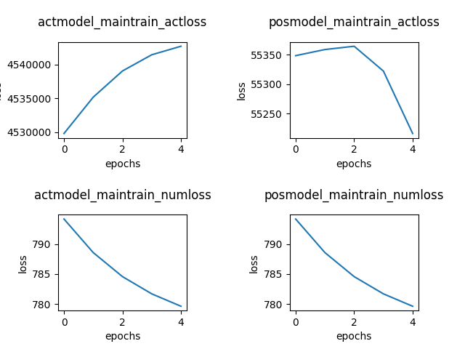

Model_3
Rup今天$以前 {{{(p}_{t}−p_{t−1})}/{p_{t−1}}}_{(200)}→$ ${fc1}_{(100)}$ $→{fc2}_{( 50 )}→{fc3}_{(20)}→{Q_{t}}_{(3)}$
$P_{(200)}→$ $→ {fc2}_{( 50 )}→{fc3}_{(20)}$ $→{{prediction}_{t+1}}_{(1)}$
act branch
pretrain act+num loss
num branch
act branch
num branch
實驗步驟
(1) Pretrain num
(2) Pretrain act
(3) Pretrain num+act
(5) Test
(4) Pretrain index
epochs = 3
epochs = 3
epochs = 3
epochs = 3
epochs = 1

Slide 15
Jeong, G., & Kim, H. Y. (2019). Improving financial trading decisions using deep Q-learning: Predicting the number of shares, action strategies, and transfer learning. Expert Systems with Applications
Model_3
Rup今天$以前 {{{(p}_{t}−p_{t−1})}/{p_{t−1}}}_{(200)}→$ ${fc1}_{(100)}$ $→{fc2}_{( 50 )}→{fc3}_{(20)}→{Q_{t}}_{(3)}$
$P_{(200)}→$ $→ {fc2}_{( 50 )}→{fc3}_{(20)}$ $→{{prediction}_{t+1}}_{(1)}$
act branch
num branch
2012-05-18
today
Component stocks
60%
40%
S&P500
60%
40%
實驗步驟
(1) Pretrain num
(2) Pretrain act
(3) Pretrain num+act
(5) Test
(4) Pretrain index
epochs = 3
epochs = 3
epochs = 3
epochs = 3
epochs = 1

Slide 16
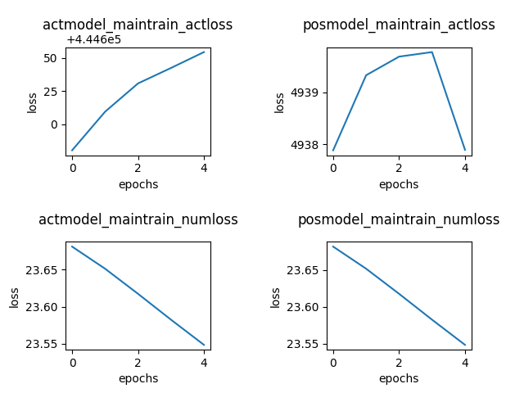

Model_3
Rup今天$以前 {{{(p}_{t}−p_{t−1})}/{p_{t−1}}}_{(200)}→$ ${fc1}_{(100)}$ $→{fc2}_{( 50 )}→{fc3}_{(20)}→{Q_{t}}_{(3)}$
$P_{(200)}→$ $→ {fc2}_{( 50 )}→{fc3}_{(20)}$ $→{{prediction}_{t+1}}_{(1)}$
act branch
maintrain act+num loss
num branch
實驗步驟
(1) Pretrain num
(2) Pretrain act
(3) Pretrain num+act
(5) Test
(4) Pretrain index
epochs = 3
epochs = 3
epochs = 3
epochs = 3
epochs = 1

Slide 17
Jeong, G., & Kim, H. Y. (2019). Improving financial trading decisions using deep Q-learning: Predicting the number of shares, action strategies, and transfer learning. Expert Systems with Applications
Model_3
Rup今天$以前 {{{(p}_{t}−p_{t−1})}/{p_{t−1}}}_{(200)}→$ ${fc1}_{(100)}$ $→{fc2}_{( 50 )}→{fc3}_{(20)}→{Q_{t}}_{(3)}$
$P_{(200)}→$ $→ {fc2}_{( 50 )}→{fc3}_{(20)}$ $→{{prediction}_{t+1}}_{(1)}$
act branch
num branch
2012-05-18
today
Component stocks
60%
40%
S&P500
60%
40%
實驗步驟
(1) Pretrain num
(2) Pretrain act
(3) Pretrain num+act
(5) Test
(4) Pretrain index
epochs = 3
epochs = 3
epochs = 3
epochs = 3
epochs = 1

Slide 18
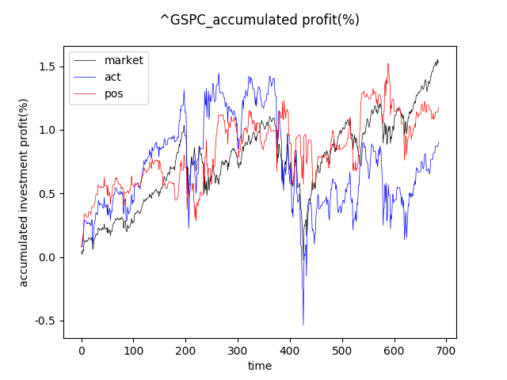
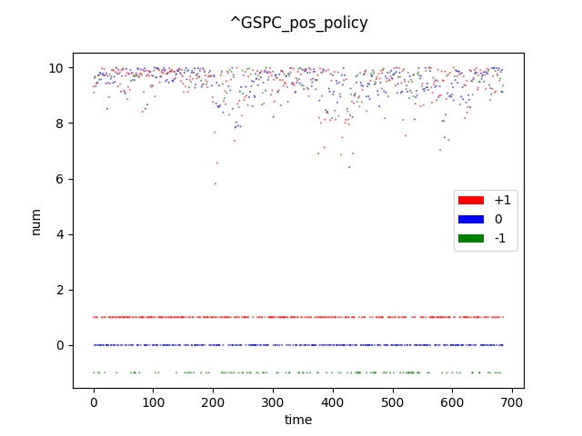
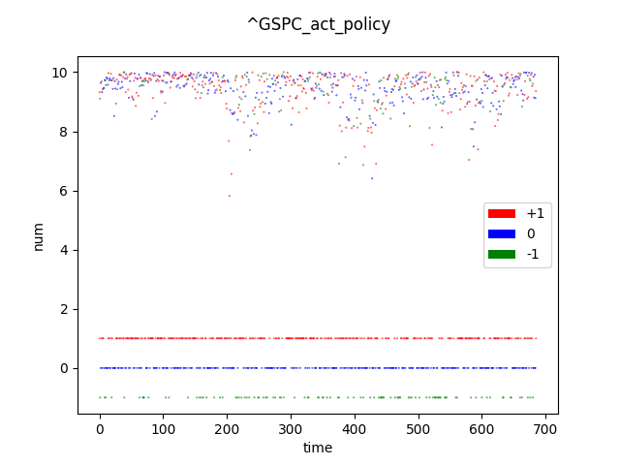
S&P500
Accumulated profit(%)
實驗步驟
(1) Pretrain num
(2) Pretrain act
(3) Pretrain num+act
(5) Test
(4) Pretrain index
epochs = 3
epochs = 3
epochs = 3
epochs = 3
epochs = 1

Slide 19
S&P500
Accumulated profit(%)
paper
實驗步驟
(1) Pretrain num
(2) Pretrain act
(3) Pretrain num+act
(5) Test
(4) Pretrain index
epochs = 3
epochs = 3
epochs = 3
epochs = 3
epochs = 1

Slide 20

THE END

